Slide 1
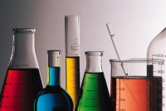
Lab Equipment

Slide 2
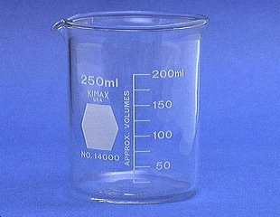
Beaker
Beakers hold solids or liquids that will not release gases when reacted or are unlikely to splatter if stirred or heated.

Slide 3
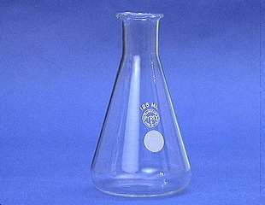
Erlenmeyer Flask
Erlenmeyer flasks hold solids or liquids that may release gases during a reaction or that are likely to splatter if stirred or heated.

Slide 4
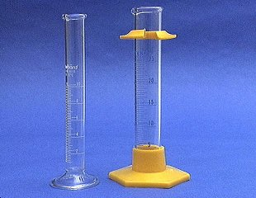
Graduated Cylinder
A graduated cylinder is used to measure volumes of liquids.
3 things to remember when reading a graduated cylinder
1. Read at eye level
2. Place on a flat surface
3. Read at the bottom of
the meniscus.

Slide 5
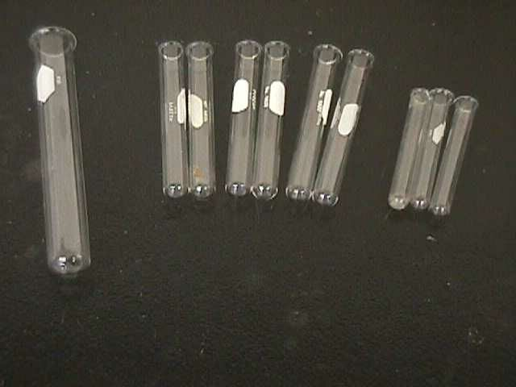
Test Tubes
13 x 100 mm test tubes
Ignition
tube
10 x 75 mm test tubes
Used to hold substances or perform reactions.

Slide 6
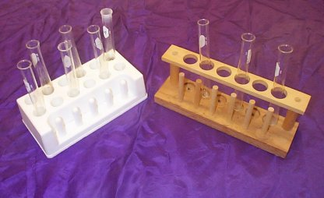
Test Tube Racks
Test tube racks are for holding and organizing test tubes on the laboratory counter.

Slide 7
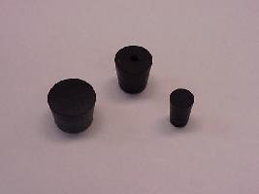
Rubber Stoppers
Rubber stoppers are used to close containers to avoid spillage or contamination.
Containers should never be heated when there is a stopper in place.

Slide 8
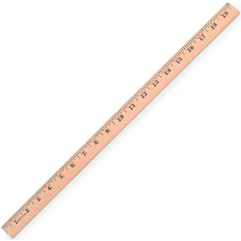
Meter Stick
Meter sticks are used to measure distance in millimeters (mm), centimeters (cm), and meters (m).

Slide 9
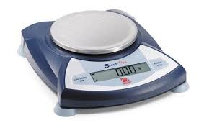
Electronic Balance
Electronic balances are used to measure the mass of an object in grams (g).

Slide 10
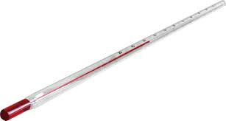
Thermometer
Thermometers are used to measure the temperature of a substance in Celsius (°C).

Slide 11
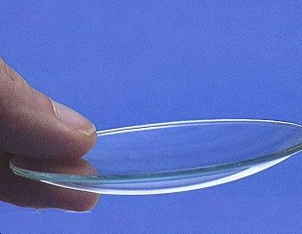
Watch Glass
A watch glass is used to hold a small amount of solid, such as the product of a reaction.

Slide 12
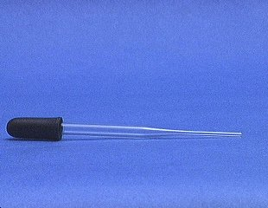
Medicine Dropper or Pipette
A medicine dropper is used to transfer a small volume of liquid (less than one mL).
On top of each medicine dropper is a “rubber bulb”

Slide 13
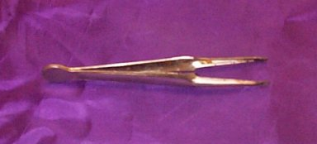
Forceps
Forceps (or tweezers) are used to pick up small objects.

Slide 14
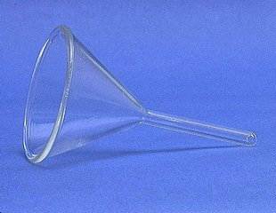
Funnel
A funnel is used to aid in the transfer of liquid from one vessel to another.

Slide 15
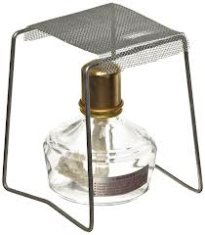
Alcohol Burner
Used to heat substances
Burner Stand
Used to transfer heat evenly to substances.

Slide 16
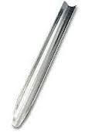
Scooplas
Scooplas are used to transfer solids.
Scooplas are larger than spatulas.

Slide 17
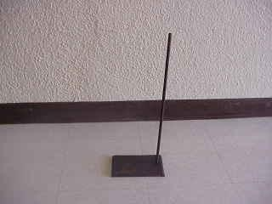
Ringstands and their Components
Ringstands are a safe and convenient way to perform reactions that require heating using fire.

Slide 18
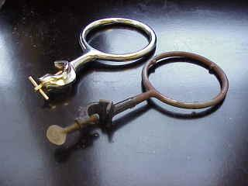
Ringstands and their Components Iron Rings
Iron rings connect to a ringstand and provide a stable, elevated platform for the reaction.

Slide 19
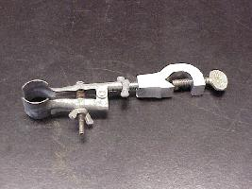
Ringstands and their Components Test Tube Clamp
Test tube clamps are used to secure test tubes to the ring stand.

