Slide 1
Layers of the Earth

Slide 2
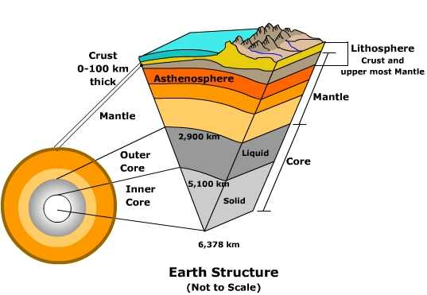
Layers of the Earth
How many layers of the Earth are there?
Crust
Continental Crust
Oceanic Crust
Mantle
Lithosphere
Astheosphere
Outer Core
Inner Core

Slide 3
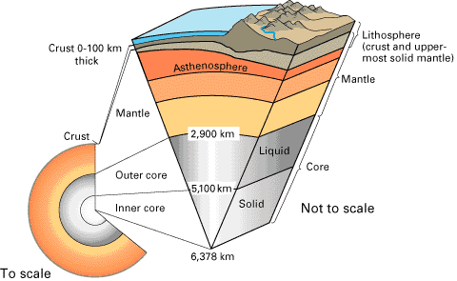
Continental Crust
Depth – About 60 km
Temp – Air Temp – about 400 deg C
Composition – Granite Rocks
Phase – Solid: Beneath the Land
Special Characteristics:
Density is about 2.7 g/cm³ and is less dense than oceanic.
About 4 billion years old.

Slide 4
Oceanic Crust
Depth – About 5 km
Temp – Air temp to About 400 deg C
Composition: Basalt Rocks
Phase – Solid: Beneath Oceans
Special Characteristics:
Density is about 2.9 g/cm³
About 200 million years old

Slide 5
Mantle – Lithosphere
Lithos means “rocky”
Lithosphere is the Earth’s Crust and top layer of the mantle.
Depth – Down to About 150 km
Temp – 1000 deg C – 3700 deg C
Composition – Silicate rocks (silicon and oxygen)
Phase – Solid
Special Characteristics
Non flowing material.
Composed of plate tectonics.

Slide 6
Mantle – Asthenosphere
Astheno means “weak”
Asthenosphere is below the lithosphere and drives the movement of plate tectonics.
Depth – Down to about 2900 km
Temp – 1000 deg C to 3700 deg C
Composition – Iron, Magnesium, Aluminum, Silicon, Oxygen
Matter – Solid but flows like a liquid (think tar or silly putty material)
Special Characteristics
Convection currents provide motion

Slide 7
Outer Core
Depth – Down to about 5100 km
Temp – 3700 deg C to 4300 deg C
Composition – Dense iron and nickel
Matter – Liquid because of extreme high temperatures.
Special Characteristics:
Convection currents of molten iron generate the Earth’s magnetic field by conducting electricity.

Slide 8
Inner Core
Depth – Extends to center of Earth to about 6400 km
Temp - Greater than 4300 deg C
Composition – Mostly Iron
Phase – Solid – Extremely high pressures cause it from becoming a liquid.
Special Characteristics
Shaped like a ball

