Slide 1
Rocks and the Rock Cycle

Slide 2
Today’s Objectives
Analyze and identify common types of igneous, sedimentary and metamorphic rocks.

Slide 3
What is a rock?
Rock: Earth material made of minerals, glass or organic matter

Slide 4
Types of Rocks
3 types of rocks:
Igneous
Meaning “of fire”
Sedimentary
Meaning “of sediments”
Metamorphic
Meaning “to change form”

Slide 5
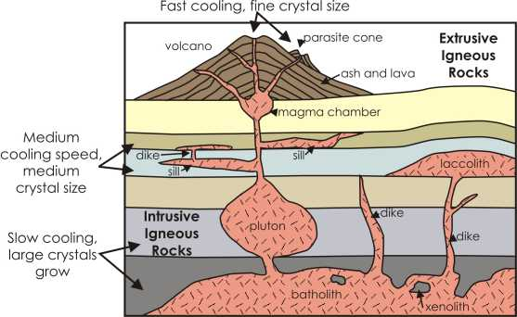
Igneous Rocks: rock formed when magma or lava cools

Slide 6
Lava: molten rock from a volcano flowing on Earth’s surface
Magma: molten rock beneath Earth’s surface
Igenous rocks form 2 different ways:
Intrusive: igneous rocks that form below Earth’s surface (plutonic)
Extrusive: igneous rocks that form when magma extrudes onto Earth’s surface and cools as lava (volcanic)

Slide 7
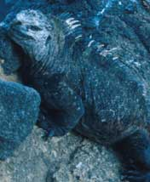
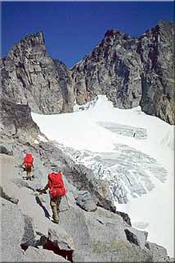
Classifying Igneous Rocks
Basaltic or Mafic: dark-colored igneous rocks that form from magma rich in iron & magnesium (high ferromagnesium minerals; low silica)
Granitic or Felsic: light-colored igneous rocks, form from magma rich in silicon and oxygen (low ferromagnesium minerals; high silica)

Slide 8
Igneous Rock Textures
A rock’s texture depends on the
- size,
- shape, and
- arrangement of crystals
A crystal’s size and shape depends:
- rate of cooling
- amount of dissolved gasses

Slide 9
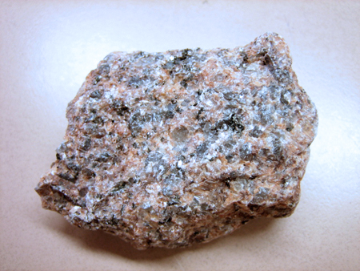
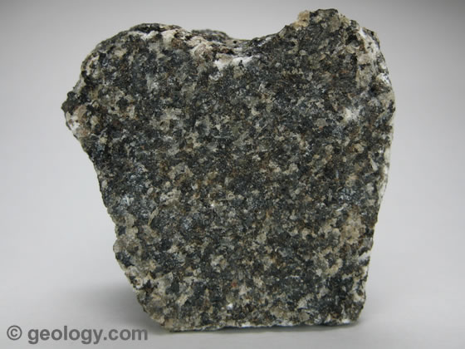
Coarse Grained
Mineral grains large enough to be seen with the unaided eye (Phaneritic):
Granite or Gabbro

Slide 10
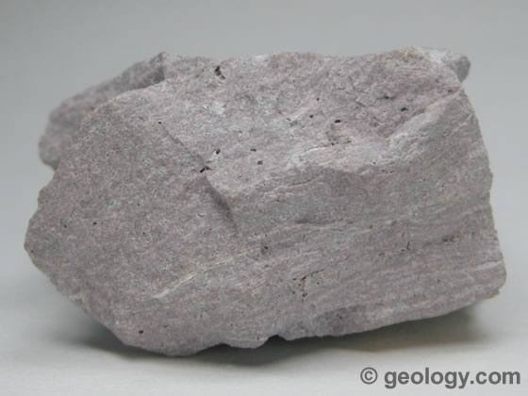
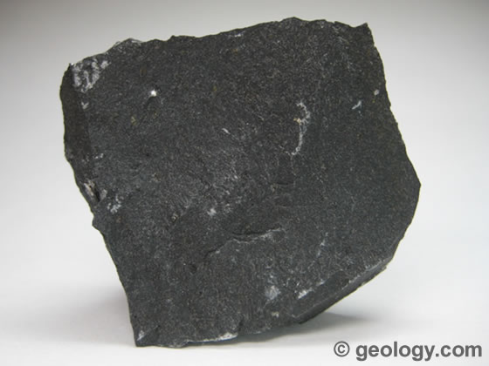
Fine Grained
Mineral grains too small to be seen with the unaided eye (Aphanitic):
For example: Rhyolite or Basalt

Slide 11
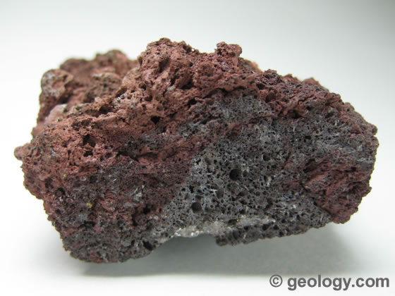
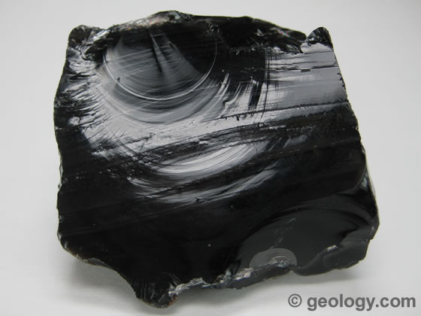
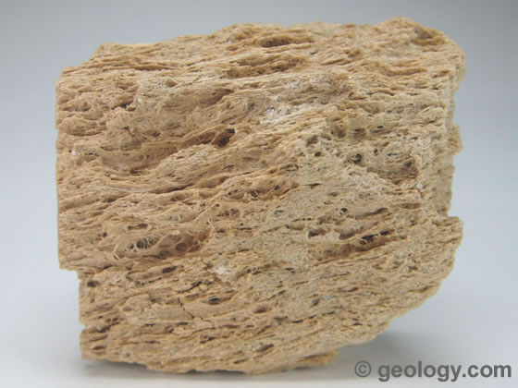
Glassy
Cooled so quickly that no crystals were able to be formed
Obsidian Scoria
or Pumice

Slide 12
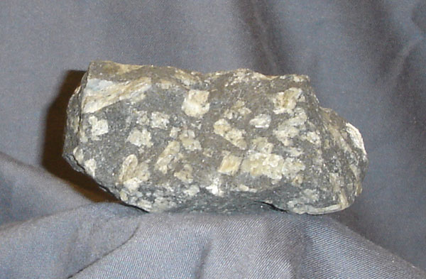
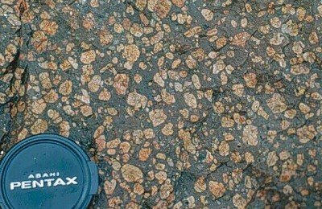
Porphyritic Texture
Displays two stages of cooling… slow and then fast (or quenched)
Porphyry

Slide 13
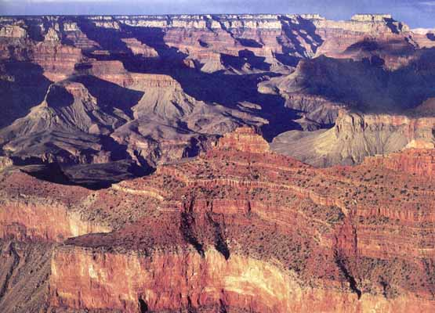
Sedimentary Rocks: rock formed when sediments become pressed or cemented together

Slide 14
What are Sedimentary Rocks Made of?
Sediments: loose materials such as rock fragments and mineral grains that have been transported by wind, water, or glaciers

Slide 15
How Sedimentary Rocks are Made
Weathering: the breaking of rocks into smaller pieces, either mechanically or chemically
Erosion: the process that moves weathered rocks from one location to another
Deposition: the build up of sediments on the bottoms of lakes, valleys and the ocean floor usually in layers

Slide 17
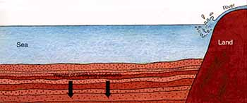
Compaction: sedimentary rock-forming process that occurs when layers of sediment become compressed by the weight of layers above them
Cementation: sedimentary rock-forming process in which sediments are glued together by minerals deposited between the sediments

Slide 18
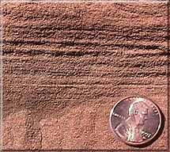
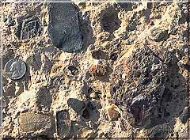
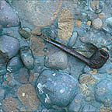
Three types of Sedimentary Rocks:
Clastic Sedimentary Rock: made of broken fragments of plants, animals, and primarily other rocks

Slide 19
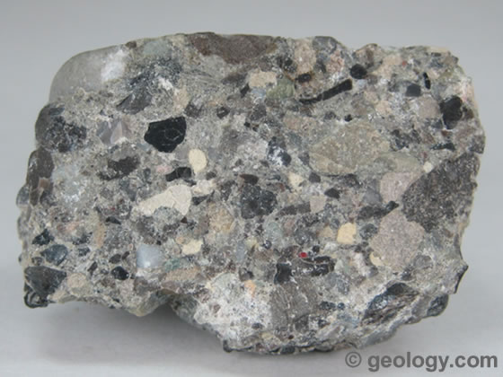
Examples of Clastic Sedimentary Rocks
Conglomerate- composed of rounded, pebble-sized fragments that are held together by a cement

Slide 20
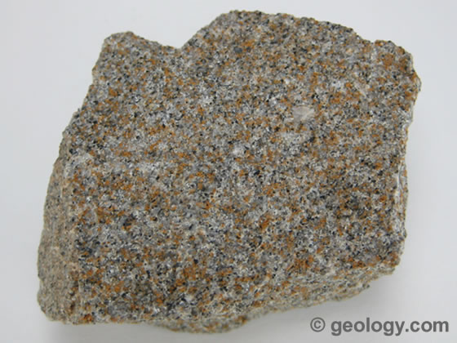
Examples of Clastic Sedimentary Rocks
Sandstone – composed of small mineral grains (usually quartz) that are cemented together.

Slide 21
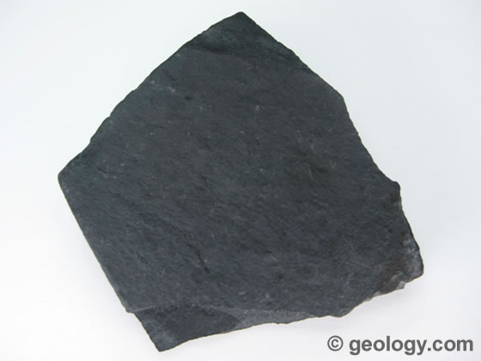
Examples of Clastic Sedimentary Rocks
Shale – made of flaky clay particles that compress into flat layers

Slide 22
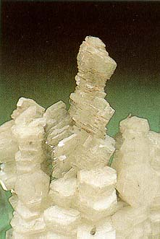
Chemical Sedimentary Rocks
made from minerals precipitated from a solution or are left behind when a solution evaporates – minerals left behind form rocks called evaporites
Rock salt (halite) →

Slide 23
Organic Sedimentary Rock
primarily made from the remains of once living things

Slide 24
Examples of Organic Sedimentary Rock
Limestone
Fossiliferous Limestone
Chalk

Slide 25
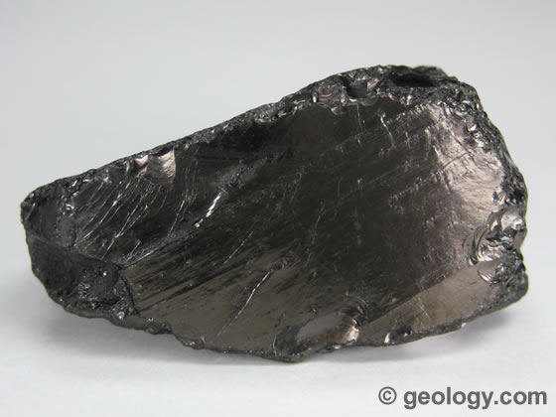
Example of Organic Sedimentary Rock
Coal - forms from plant remains that are buried before they decay. The plant layers are then compacted into matter that is composed mostly of carbon

Slide 26
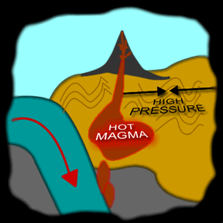
Metamorphic Rock: rock formed from existing rock when the temperature or pressure changes

Slide 27
Textures of Metamorphic Rocks
Foliated: a texture of metamorphic rock, created when mineral grains flatten and line up in parallel bands
Nonfoliated: texture of metamorphic rock, created when mineral grains change, grow, & rearrange but don’t form bands

Slide 28
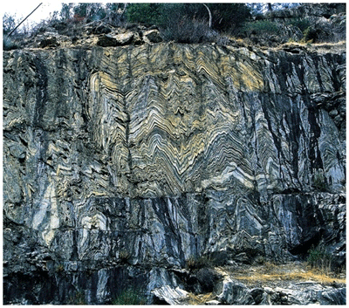
Local Metamorphism
metamorphism that affects relatively small volumes of rock (less than 100 km³)

Slide 29
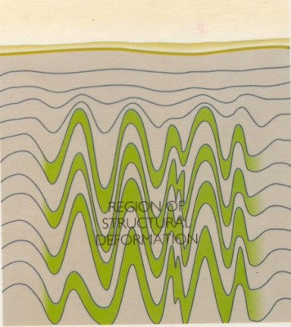
Regional Metamorphism
metamorphism that affects thousands of (km³) cubic kilometers of rock

Slide 30
Contact Metamorphism
metamorphism where temperature is the primary agent
Limestone
Marble
Basalt
Marble
Limestone
http://academic.brooklyn.cuny.edu/geology/grocha/monument/images/metheat.gif

Slide 31
Dynamic Metamorphism
metamorphism where pressure is the primary agent (aka deformational metamorphism)
http://www.indiana.edu/~g103/G103/wk5/week5.htm

Slide 32
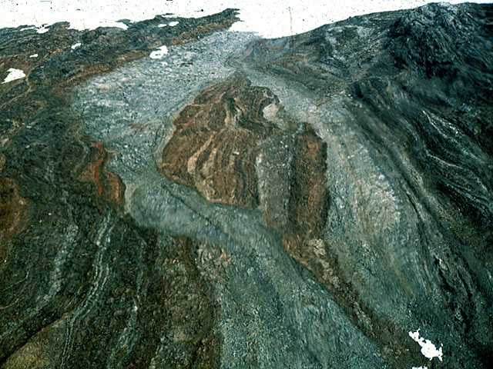
Result of Dynamic Metamorphism

Slide 33
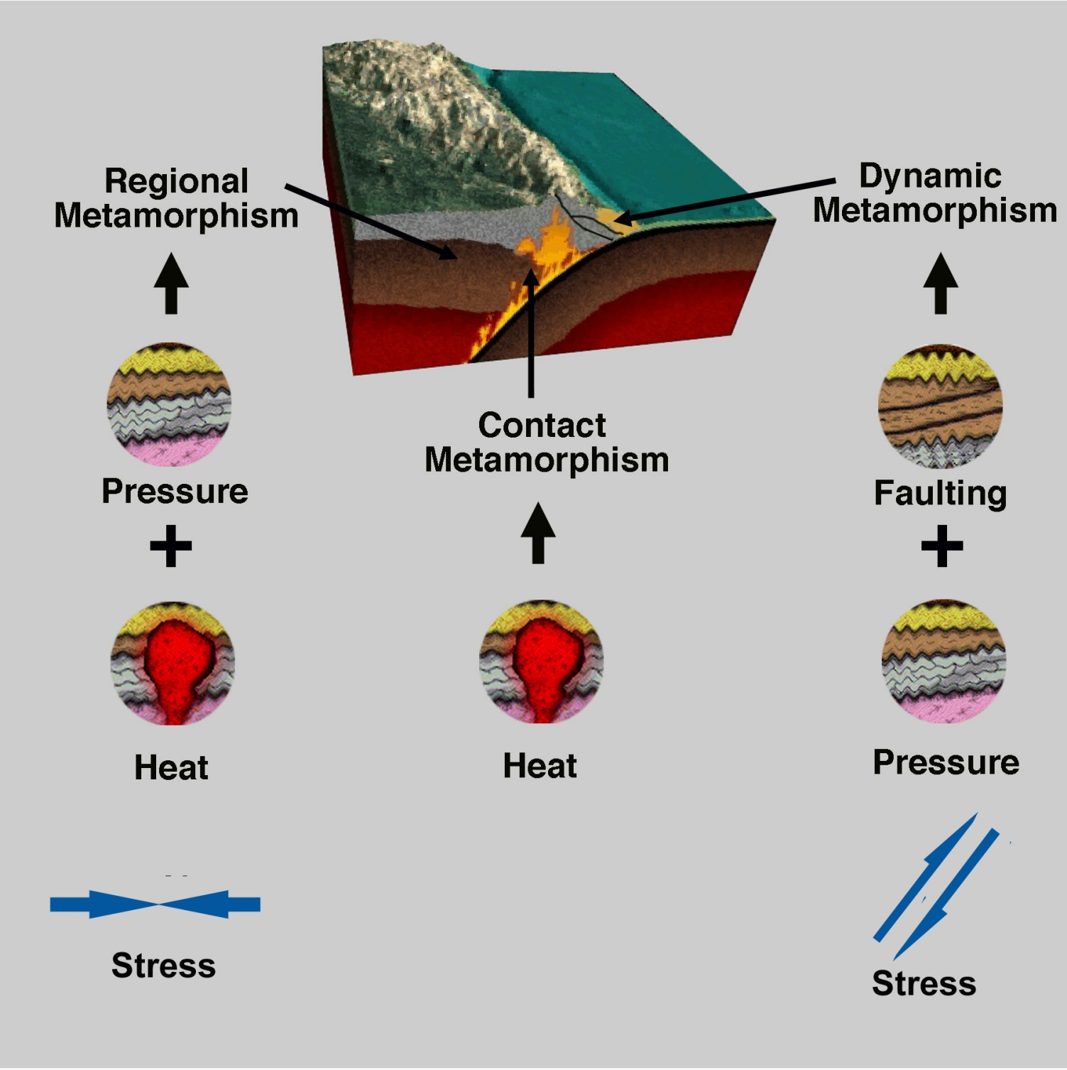
http://www.indiana.edu/~g103/G103/wk5/week5.htm

Slide 34
Examples of Metamorphic Rocks
Gneiss – metamorphosed granite, displays foliation and banding; a result of high grade metamorphism
(foliated texture)
kinked gneiss →

Slide 35
Examples of Metamorphic Rocks
Slate – pressure exerted on shale (claystone/
mudstone)
Schist – high heat and pressure exerted on slate
(both with foliated texture)
http://library.thinkquest.org/05aug/00461/images/slate.jpg
http://www.windows.ucar.edu/tour/link=/earth/geology/images/Schist_mica_jpg_image.html

Slide 36
Examples of Metamorphic Rocks
Quartzite – metamorphosed quartz sandstone (looks like fine crystalline structure)
Marble – formed from the compression of limestone (looks like numerous calcite crystals)
http://www.answersincreation.org/curriculum/geology/images/Quartzite_2_jpg.jpg
(both with nonfoliated texture)
http://www.answersincreation.org/curriculum/geology/images/Marble_2_jpg.jpg

