Slide 1
Mixtures, Solutions and Solubility
December 13, 2013

Slide 2
Today’s Objective
SWBAT:
Explain the difference between mixtures and solutions.
Identify the solute and solvent in various solutions
Analyze how unsaturated, saturated and supersaturated solutions relate to solubility.

Slide 3
Characteristic Properties
We have talked about 4 different characteristic properties:
Density
Freezing Point
Melting Point
Boiling Point
There is a 5th characteristic property that we will look at this chapter – Solubility. But before we get to solubility we need some background information first.

Slide 4
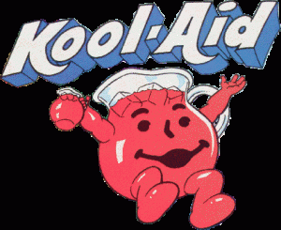
Mixtures
Mixtures are combinations of two or more substances NOT chemically combined.
2 types of Mixtures
Homogeneous Mixtures – Substances are distributed
evenly throughout the mixture
Homo = Same
Any 2 samples taken will have same proportions of ingredients.
Examples: Sugar water, salt water, iced tea, maple syrup

Slide 5
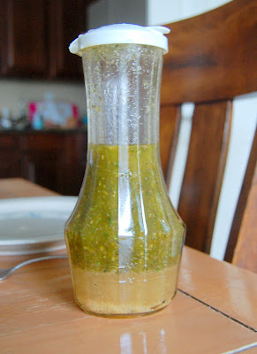
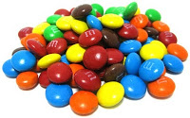
Mixtures (cont.)
Heterogeneous Mixtures are mixtures that have an unequal distribution of substances.
Hetero – different
Any 2 samples can have different proportions of substances
Examples: orange juice, chocolate chip pecan cookie, salad, pack of M&M’s, Italian dressing

Slide 6
Think, Pair, Share
In the next 2 minutes, I want you to come up with 3 different types of homogenous solutions and 3 different types of heterogeneous solutions.
Now, take a minute and share with the person next to you.
Now we can all report out!

Slide 7
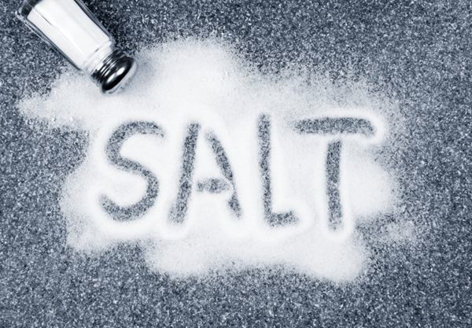
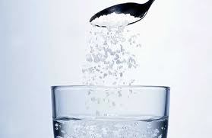
Solutions
Solutions are a special type of homogenous mixture in which one substance is dissolved in another.
Two parts to a solution
Solute – The substance that is being dissolved. (ex. Salt)
Solvent - The substance that is doing the dissolving (ex. Water)
Solute + Solvent = Solution

Slide 8
More on Solutes and Solvents
Solutes (substance being dissolved) can be a gas, liquid or solid.
Solvents (substance that is doing the dissolving) can also be a gas, liquid or solid.

Slide 9
Types of Solutions

Slide 10
Think, Pair, Share Round 2
In the next 2 minutes, I want you to come up with 2 examples of a solution and IDENTIFY what the solute is and what the solvent is.
Now, take a minute and share with the person next to you.
Now we can all report out!
Notes:
Wine: Ethanol (solute) Water (solvent)
Soda Pop: Carbon Dioxide (Solute) Water (solvent)
Steel: Carbon (solute) Iron (solvent)

Slide 11
Solubility
Solubility – The measure of how much solute CAN be dissolved in a solvent.
Solubility depends on factors such as temperature, pressure, amount of solvent, and pH (we’ll talk more about this later).

Slide 12
Solutions
Three types of solutions
2. Unsaturated solutions – Contains LESS solute than the solvent has the capacity to dissolve at a specific temperature – it can dissolve more solute

Slide 13
Solubility
Three types of solutions
Saturated Solutions – Contains the MAXIMUM amount of a solute that will dissolve in a given solvent at a specific temperature – it cannot dissolve anymore

Slide 14
Solutions
Three types of solutions
3. Supersaturated solutions – Contains MORE solute than is present in a saturated solution at a specific temperature – there’s too much solute.

Slide 16
Questions
One thing I learned today is ___________.
I also learned _______________________.
One questions I still have is ____________.

